Slide 1
Magic the Gathering Outlier Detection
By Hollis Nolan

Slide 2
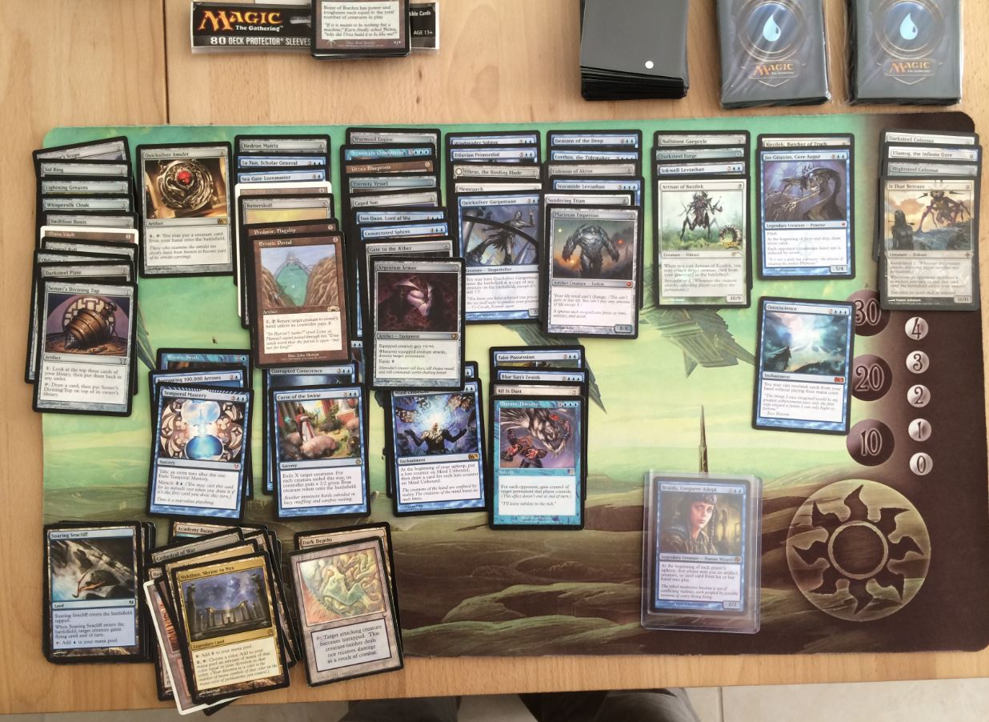
Magic the Gathering is a trading card game

Slide 3
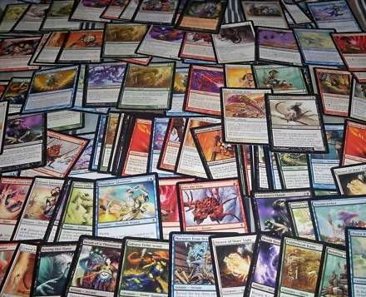
There are 13,651 different cards

Slide 4
There are 13,651 different cards Most cards are worthless

Slide 5
There are 13,651 different cards Most cards are worthless How do you find the good cards?

Slide 6
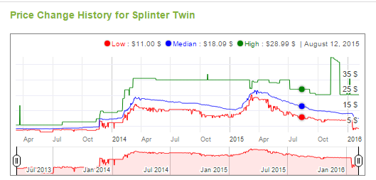
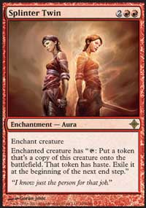
Many attempts have been made by tracking price on the used market

Slide 7
But price is a lagging feature

Slide 8
What if one could detect powerful cards before they become expensive?

Slide 9
My approach
The cards are broken up into 5 colors
(Almost) every card has rules text
Each color gets different abilities
Use the rules text to predict color
Then look at the error, the cards that the predictor got wrong, for cards that are unsual

Slide 10
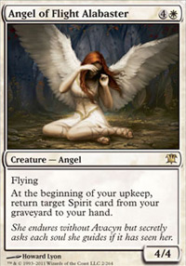
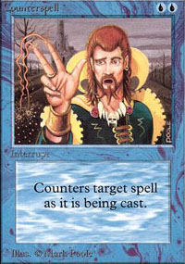
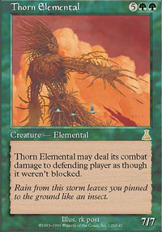
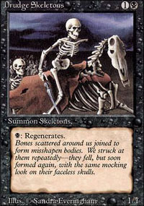
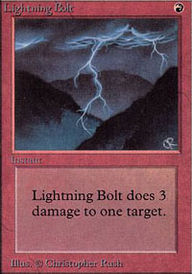
Color Theory – ability differentiation

Slide 11
Feature Engineering
Database of all cards courtesy of http://mtgjson.com/
Want to predict the color of the card from the text
Remove all stop words (a, the, of, …)
Remove all names of cards
Remove all resource symbols

Slide 12
Number the Colors
4
0
1
3
2

Slide 13
Number the Vocabulary
Trample
Flying
Damage
Life
….

Slide 14
Count the Occurrences of Words Per Card
Flying – 1
Trample – 0
Damage – 0
Graveyard – 1
Hand – 1
…

Slide 15
This Creates a Vector
Flying – 1
Trample – 0
Damage – 0
Graveyard – 1
Hand – 1
…
Class #4

Slide 16
Models Visited
Logistic Regression
Naïve Bayes
Random Forests
Gradient Boosted Random Forests

Slide 17
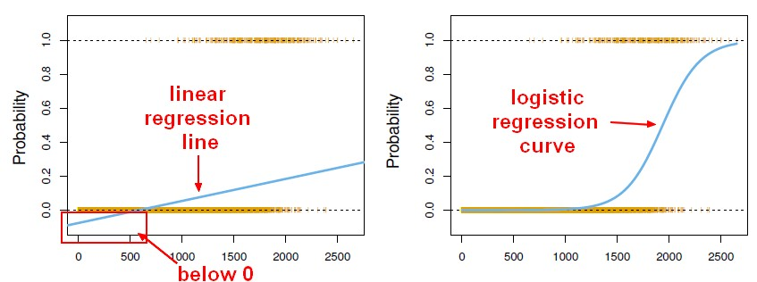
The Winner was Regression
Source: http://gerardnico.com/wiki/data_mining/simple_logistic_regression

Slide 18

One VS Rest
Fits one classifier per class
Each class is fitted against all other classes
To get the prediction, they all vote

Slide 19
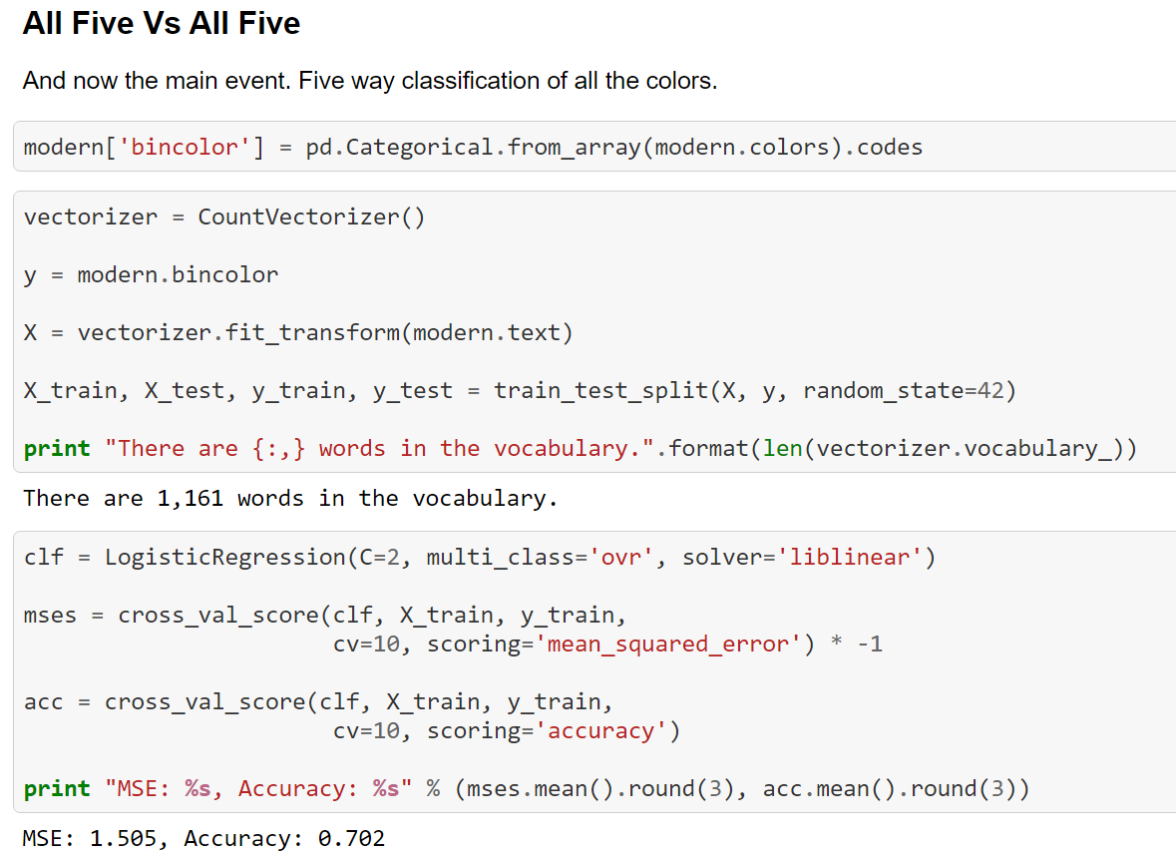
Time for Some Modeling

Slide 20
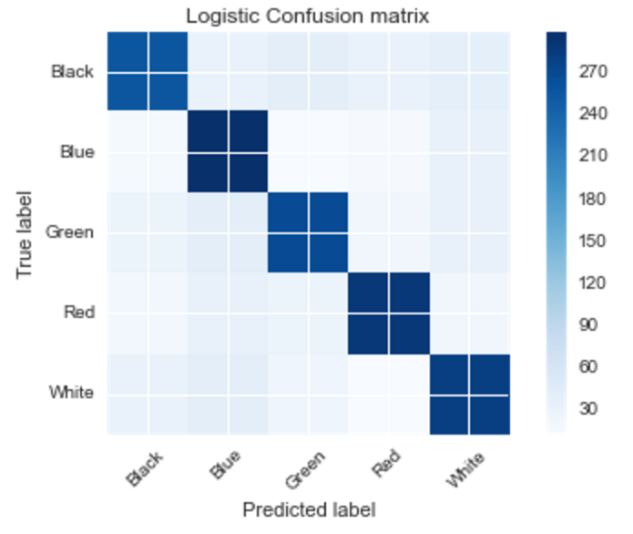
Look at What the Model Got Wrong

Slide 21
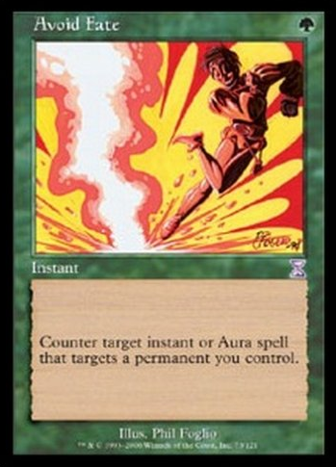
Look Up a Card that was Misclassified

Slide 22
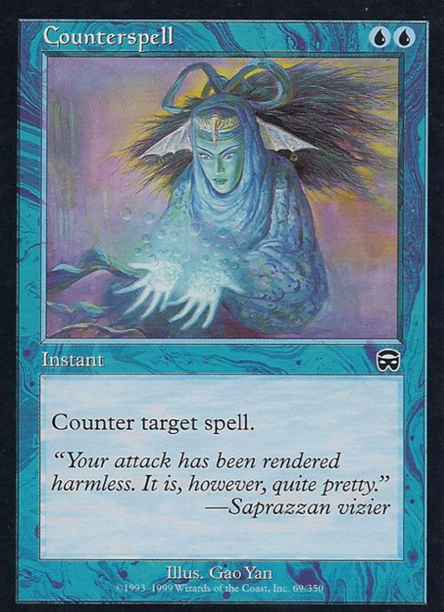
Wait, green’s not allowed to do that

Slide 23
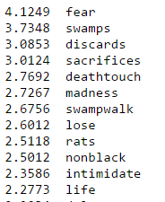
Other Interesting Results
Most informative features for class 0 (black)

Slide 24
Magic the Gathering Outlier Detection
Online at:
https://github.com/hollisn/MagicTCG_Classification
By Hollis Nolan

